Slide 1
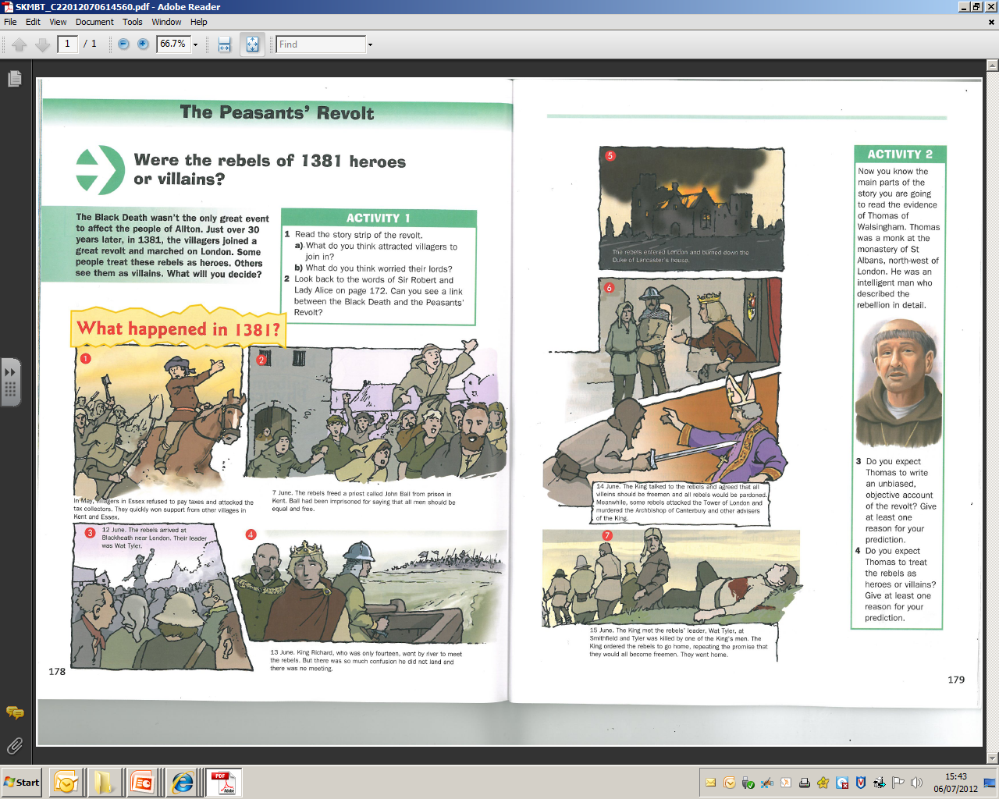
LO: to be able to explain what happened during the Peasants’ Revolt
STARTER:
Write down everything you can remember from last lesson about the Peasants’ Revolt.

Slide 2
LEARNING OUTCOMES
CORE: to be able to list the key events of the Peasants’ Revolt in chronological order (Level 3)
EXTENSION: to be able to describe what happened during key events of the Peasants’ Revolt (Level 4)
KILLER: to be able to explain why the events of the Peasants’ Revolt took place. (Level 5)

Slide 3

ALL WRITE ROUND ROBIN
In your groups take it in turn to give one fact about the Peasants’ Revolt.
The person with the shortest hair goes first – if you haven’t got it you add it to your list.
STAND UP TO SHARE!

Slide 4
At the end of the next task you will all answer these questions in your books.
When did the Peasants’ Revolt take place?
Where did the Peasants’ Revolt take place?
Who was involved in the Peasants’ Revolt?
What happened during the Peasants’ Revolt?

Slide 5
LEARNING OUTCOMES
CORE: to be able to list the key events of the Peasants’ Revolt in chronological order (Level 3)
EXTENSION: to be able to describe what happened during key events of the Peasants’ Revolt (Level 4)
KILLER: to be able to explain why the events of the Peasants’ Revolt took place. (Level 5)

Slide 6
GATHERING INFORMATION
Around the room are posters with information on.
In your pairs you must gather this information.
Only one of you can be out of your seat at any time.
You cannot take your sheet with you.

Slide 7
On your whiteboards answer these questions.
When did the Peasants’ Revolt take place?
Where did the Peasants’ Revolt take place?
Who was involved in the Peasants’ Revolt?
What happened during the Peasants’ Revolt?

Slide 8
LEARNING OUTCOMES
CORE: to be able to list the key events of the Peasants’ Revolt in chronological order (Level 3)
EXTENSION: to be able to describe what happened during key events of the Peasants’ Revolt (Level 4)
KILLER: to be able to explain why the events of the Peasants’ Revolt took place. (Level 5)

Slide 10
USE THE INFORMATION TO CREATE A STORY BOARD FOR THE PEASANTS’ REVOLT
Pick out six key events of the Peasants’ Revolt.
Write a sentence to describe who was there and what happened.
Draw an image to go with the event

Slide 11
LEARNING OUTCOMES
CORE: to be able to list the key events of the Peasants’ Revolt in chronological order (Level 3)
EXTENSION: to be able to describe what happened during key events of the Peasants’ Revolt (Level 4)
KILLER: to be able to explain why the events of the Peasants’ Revolt took place. (Level 5)

Slide 12
Richard II was only 14 in 1381; his father, Edward (The Black Prince) had been popular and was an adult but died before his father, Edward III. | Wat Tyler led a mass of people, several thousand strong, to Canterbury where, on June 10th 1381, he cried out that the Archbishop would be ‘beheaded for his iniquity’ (i.e. his unfairness to the people)
Many peasants and rebels blamed the King’s poor decisions on his adult advisors – his uncle, John of Gaunt, his royal treasurer, Sir Robert Hales, and Simon Sudbury | Before the poll tax, taxes had been raised per house rather than per person
The Black Death had returned to England in 1361, 1368, 1374 and 1379 | Richard II and his government had placed a poll tax on all of his people 3 more times since 1377

Slide 13
In 1351 Edward III had passed a law called the Statute of Labourers, which limited the pay of peasants and craftsmen and prevented them from working for whoever would pay them the highest wage. | In 1350 about half the population of England had died from the Black Death
A poll tax was a tax of 1 shilling paid by every person over the age of 14 in the kingdom, regardless of wealth. | In the early 1380s some people were influenced by new thinking and ideas, especially those of John Ball, who preached that all people had been created equal
The rebels moved from Essex and Kent into London, where they headed for the buildings where they thought they might either find the king or his advisors | Edward III had taken England to war against France in the 1330s. After some famous early victories, the war went badly later in his reign

Slide 14
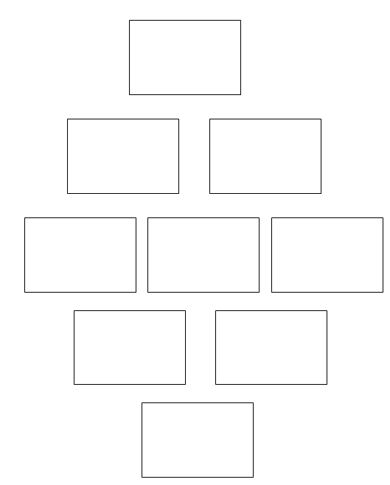
DIAMOND RANKING ACTIVITY
Which statement is the most important? Give a reason why.
Read through the statements in your envelope.
Select the NINE that you think are the most important.
Stick them into your book in a diamond
Which statement is the least important? Give a reason why.

Slide 15
SELF - ASSESSMENT
CORE: to be able to list the key events of the Peasants Revolt in chronological order (Level 3)
Are there 6 events on your storyboard in correct date order?
EXTENSION: to be able to describe what happened during key events of the Peasants Revolt (Level 4)
Also, does your storyboard have 6 events in correct order and a description of each event?
KILLER: to be able to explain why the events of the Peasants Revolt took place. (Level 5)
Also, have you explained your choices on your diamond 9?
This lesson I have achieved a Level ____ because I have been able to….
Next time I need to ….

Slide 16
PLENARY: ON WHITE BOARDS
4. What was the name of the king?
1. The Peasants’ Revolt took place in which year?
6. What was the leader of the rebels called?
7. What happened to the leader of the rebels?
2. Villagers from E_____ began the Peasants’ Revolt.
5. Whose house was burnt down?
3. What was the name of the tax the Peasants’ hated?
Notes:
1. 1381 2. Essex 3. Poll 4. Richard 5. Duke of Lancaster 6. Wat Tyler 7. He was killed

